Slide 1


Travelogues & Linked Data
<Martin Krickl> (<Österreichische Nationalbibliothek>)
<AG BIBFRAME>
<Universität Wien>

Slide 2







Notes:
Interdiscplinary project
Computer Science
Historians

Slide 3
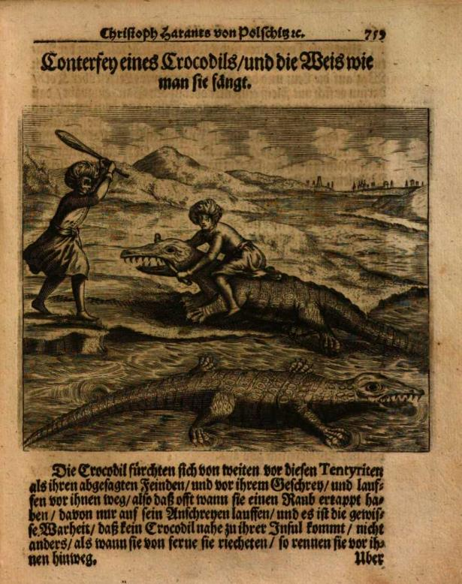
TRAVELOGUES | Motivation
A relevant historical source
Large-scale digitization offers new possibilities
Notes:
A relevant...
A lot of research on this genre
Gives insights into people’s thoughts, experiences, expectations (their own, of the ones still at home -> their audience)... “really shines a light on history”
Insights into historic dimension of the perception of the Other – probably still influences us today
Very heterogeneous
Travelers (pilgrims to merchants, from scholars to diplomats and early tourists), their destinations and motives, modes of writing
Different target audiences
Past research: has been very limited in terms of corpus size
Could develop into European-wide “bestsellers” and substantially shape the contemporary and future perception of other regions as well as their inhabitants
Large scale...
Digitization and text-mining techniques can exponentially increase the amount of text analysed
State of the art on a new domain!

Slide 4
Travelogues | Research Goals
Semi-supervised creation of a corpus
Enrichment of meta data / as much LOD ap
Perceptions of the other & discourses of the Orient
Notes:
Semi-supervised...
Characteristics and commonalities
Relationships to other texts
Important: will not cover all the travel reports (some are not digitized; we will probably not find all)
Enrichment...
Author information (name, origin, confession etc.)
Relation between different texts and authors (plagiarism, inspiration etc.)
Info from the texts like visited locations, persons/peoples mentioned etc.
Perceptions...
Key terms and the associated meanings/their usage over time
Images of religions
Relations to modern images (people(s), religions, customs... Anything else)

Slide 5
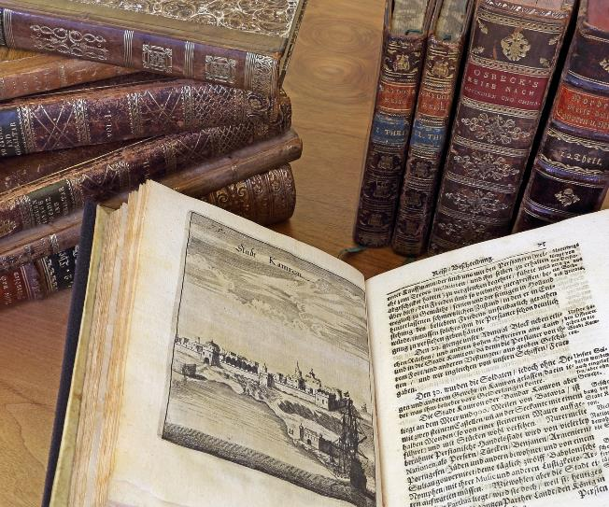
Travelogues | data set
600.000 digitalisierte historische Drucke der Erscheinungsjahre 1500-1877 (ABO)
Circa 3500 Reiseberichte
OCR verfügbar (Googlebooks)
Da fehlerhaft Task OCR-postcorrection
Von “basalen” Metadaten zu “quality-data”
Niemals datacleaning und dataenrichment unterschätzen
Notes:
Inventory of the Austrian National Library (Habsburger collection)
Focus on German-language publications
Timeframe: 1500 due to printing, 1875 to avoid copyright problems
OCR done through Google Books project; word-level
Meta data in part from 19th century, different standards etc. make it difficult

Slide 6
Quality Data?
Big data – smart data und “big smart data” als Währung der Bibliotheken
[Christof Schöch: Big? Smart? Clean? Messy? Data in the Humanities. In: Journal of Digital Humanities 2.3 (2013)]
Transformationen der Funktionen von Bibliothekskatalogen – Vom indexikalischen Nachweissystem zum Hub für “quality-data”
“Quality data” as “trading good” – “weight – trust and comparability via IDs”
[Raphaël Lapôtre: Library Metadata on the wen: the example of data.bnf.fr. In: JLIS.it 8.3. (2017)]
Was heißt “quality data” für wen und was heißt “quality cataloging”?
[Karen Snow: Defining, Assessing, and Rethinking Quality Cataloging. In: Cataloging & Classification Quarterly 55.7-8 (2017), 438-455]

Slide 7
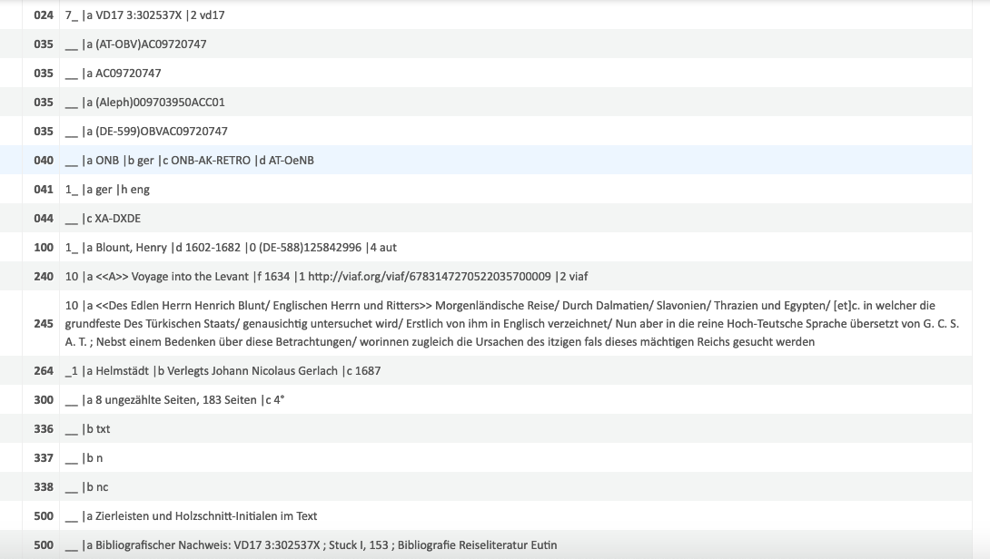
Quality Data in travelogues

Slide 8
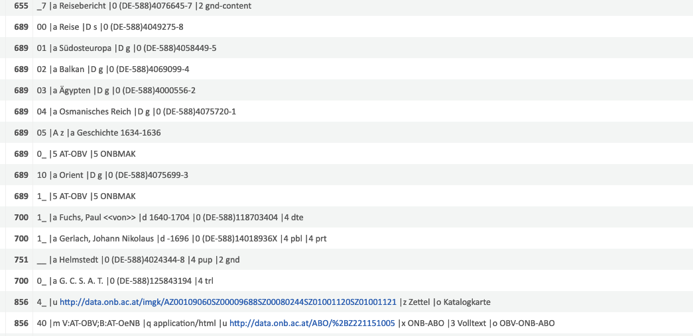
Quality Data in travelogues

Slide 9
Travelogues Data | ONB-LOD
Linked Open Data Strategie-Gruppe an der ONB [Georg Petz]
Bereitstellung der SRU und OAI-PMH-Schnittstellen über labs.onb.ac.at
Evaluation der Ausgabeformate im Rahmen des Travelogues-Projektes:
Ausgaben in sekundären Format (CSV, Excel) über ein JupyterNotebook auf Basis des originären Eingabeformates MARC21.
Testsieger BIBFRAME: Minus jedoch Schlagworte und Hierarchien
Unbrauchbar: RDF/ RDA ; DC ; JSON-LD
JSON-LD für Corpuspublikation aus SACHA MODS

Slide 10
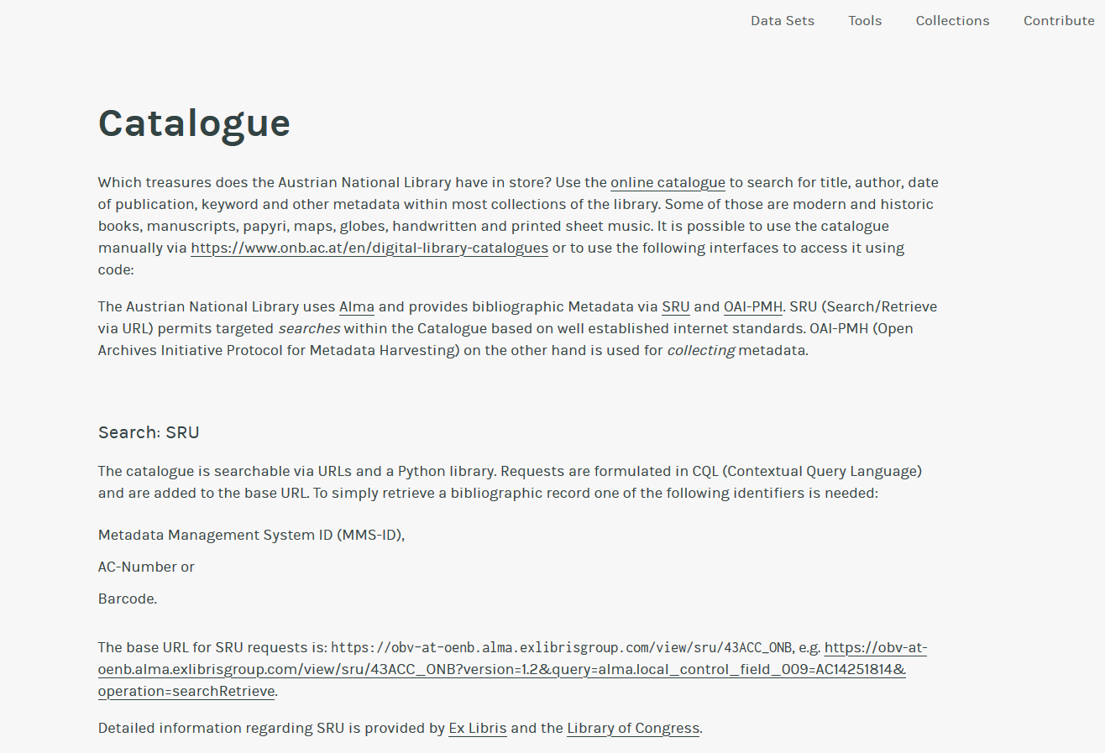

Slide 11
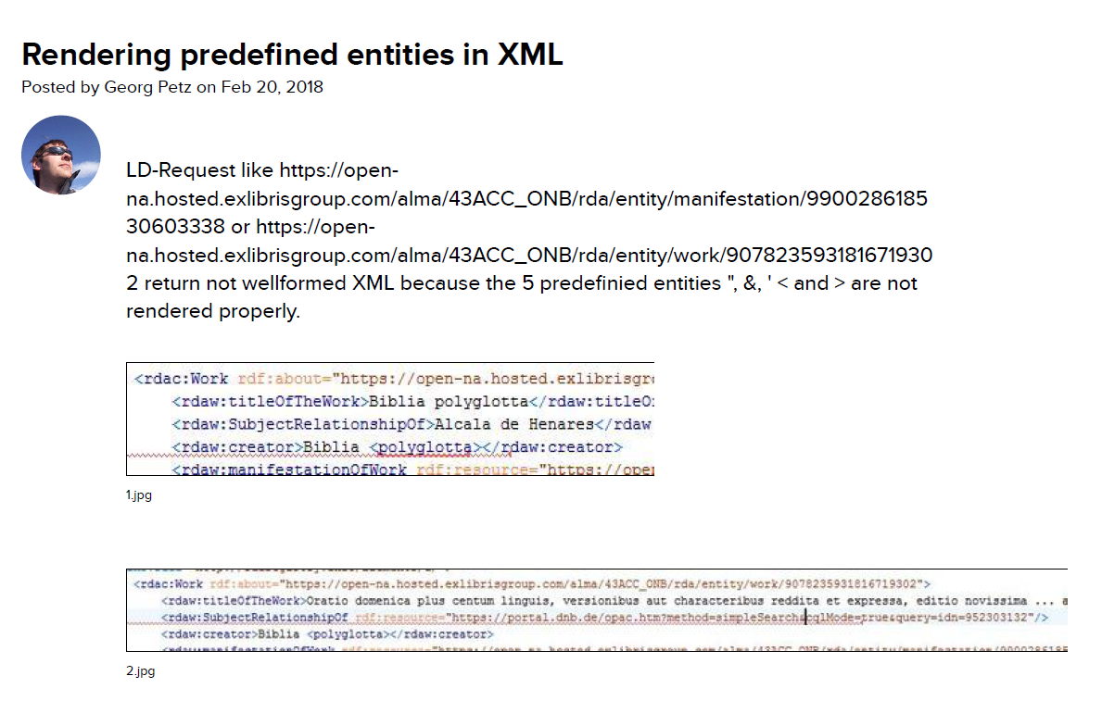

Slide 12
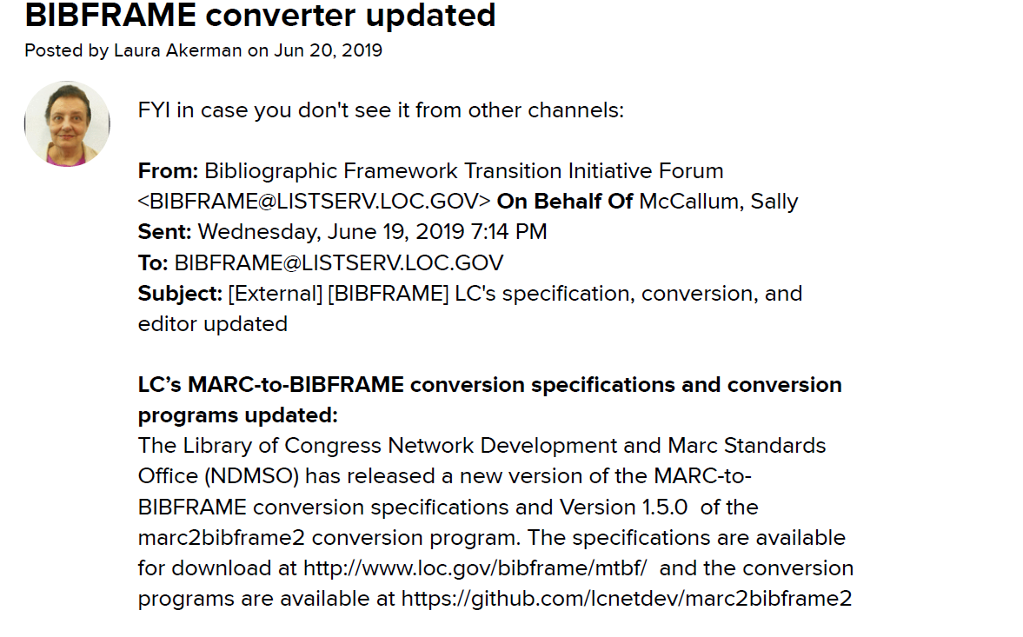

Slide 13
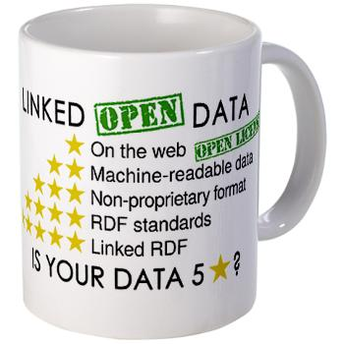
Evaluation of Linked Open Data
Wo stehen wir im ÖBV? Wo stehen einzelne Bibliotheken?
“Linky MARC” als Zwischenstufe?
[Richard Wallis: MARC and beyond: our three Linked Data choices. IFLA WLIC 2018]
Hat RDF immer noch diese “Exklusivität”?
Welche Probleme gilt es im ÖBV zu addressieren?
[Bsp. Identifier, Integration von URIs ; Ausweisung von LD im OPAC]
Burners-Lee (2009) www.w3gorg/DesignIssues/LinkedData

Slide 14
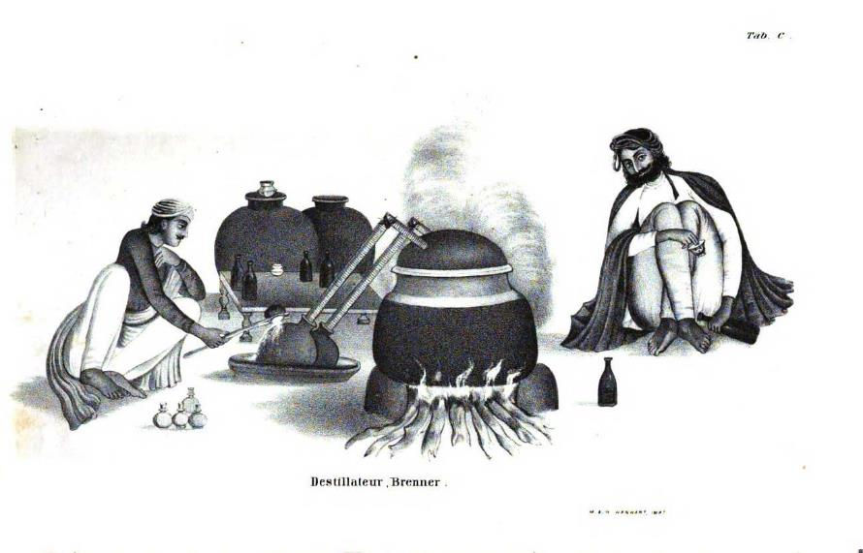
LOUD Quality-Data FROm and FOR?
Welche Quellen haben für welche Communities (User) welche Relevanz?
[Bsp. Wikidata: Wikidata für Bibliotheksdaten oder Bibliotheksdaten für Wikidata?]
Ist das Format sekundär? Welche Anforderungen stellt die Forschungscommunity?
Wie kann “quality data” für und mit domänenspezifischen Nutzern generiert werden? [Know your community!]

Slide 15
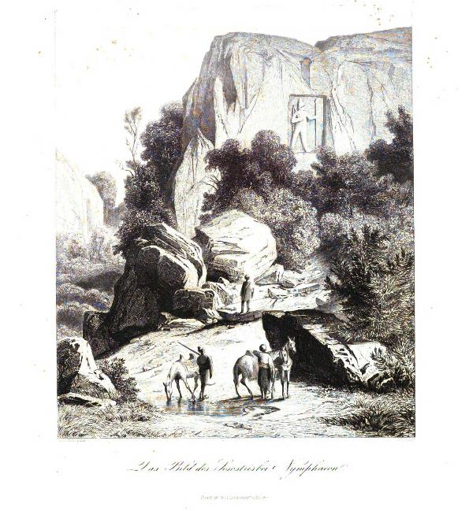
LINKEN OPEN USABLE Quality Data
Ein langer steiniger Weg?

Slide 16
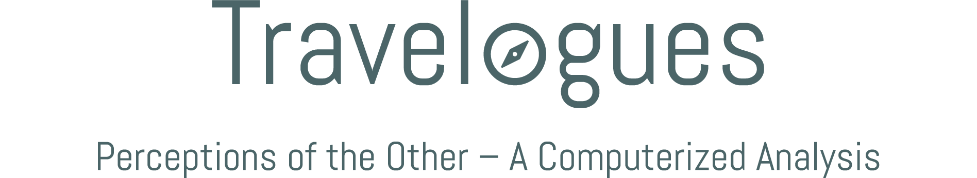
www.travelogues-project.info
<name>@<email>.at

